Slide 1
Diffusion Models for
Image Inpainting
6th April, 2024
EE 350: Technical Communications
Technical presentation
Rohan Nafde, 210070068
E-mail: rohannafde212@gmail.com
Github: https://github.com/RohanNafde/Diffusion-Models-for-Image-Inpainting

Slide 2
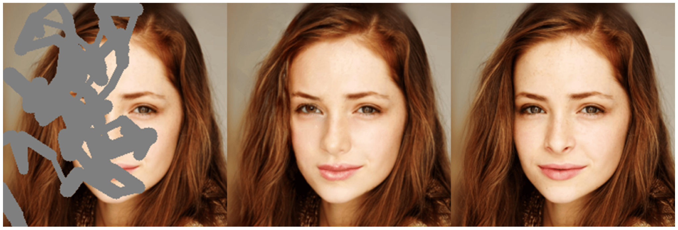
Motivation and Problem Statement
Motivation: Many a times it happens we have an image with some regions tampered or missing overtime. Be it an actual hard-copy or a soft-copy. We also wish to modify an image by removing unwanted objects or enhance the quality. All this require a technique known as image inpainting using the various diffusion models.
Problem Statement: To understand, analyze and compare different diffusion models for image inpainting (reconstruction of distorted image).
Figure [5] Example of image inpainting
Figure Source: https://www.mdpi.com/sensors/sensors-20-03204/article_deploy/html/images/sensors-20-03204-g001.png

Slide 3
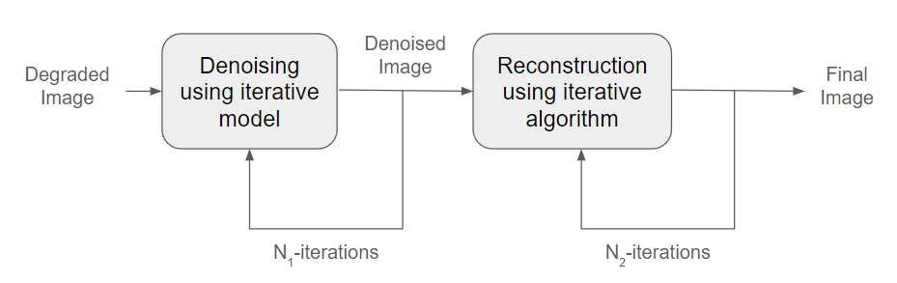
PDE Based Image Inpainting
Figure [1] Block Diagram of PDE Based Image Inpainting
A cost functional J(u) is to be minimised in each case.
This is done by solving the Euler-Lagrange equation to get optimal u_{min}.
The solution thus obtained is now analysed to get discrete form, which is implemented in the iterative model of denoising and reconstruction.
Figure adapted from: [1] m T. Barbu, A. Ciobanu and M. Luca, "PDE-based image restoration using variational denoising and inpainting models," 2014 18th International Conference on System Theory, Control and Computing (ICSTCC), Sinaia, Romania, 2014, pp. 688-691, doi: 10.1109/ICSTCC.2014.6982497.

Slide 4
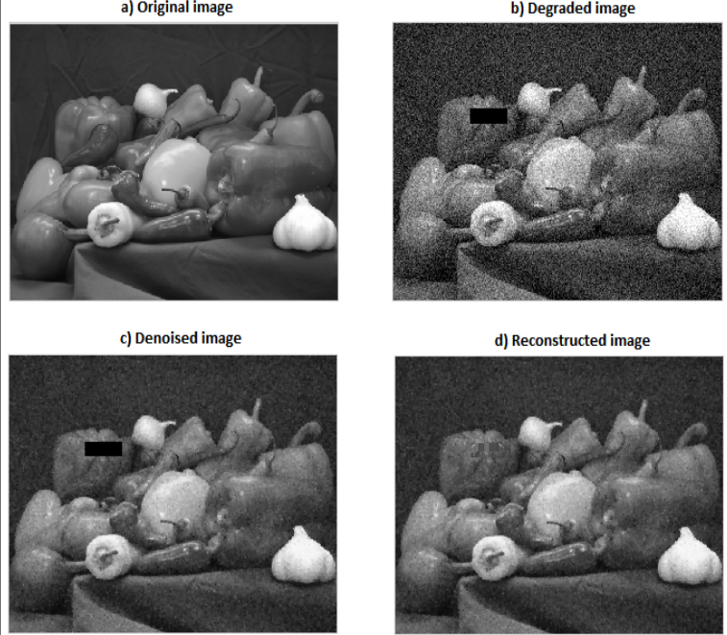
PDE Based Image Inpainting
The degraded image involves removal of an image region and addition of noise.
After many iterations, the noise is reduced as seen in part (c).
This denoised image is fed into the reconstructor and is iterated through multiple times until the restored image matches closely to the original one.
Figure [1] Example
Figure source: Fig. 1. Page 690 [1] T. Barbu, A. Ciobanu and M. Luca, "PDE-based image restoration using variational denoising and inpainting models," 2014 18th International Conference on System Theory, Control and Computing (ICSTCC), Sinaia, Romania, 2014, pp. 688-691, doi: 10.1109/ICSTCC.2014.6982497.

Slide 5
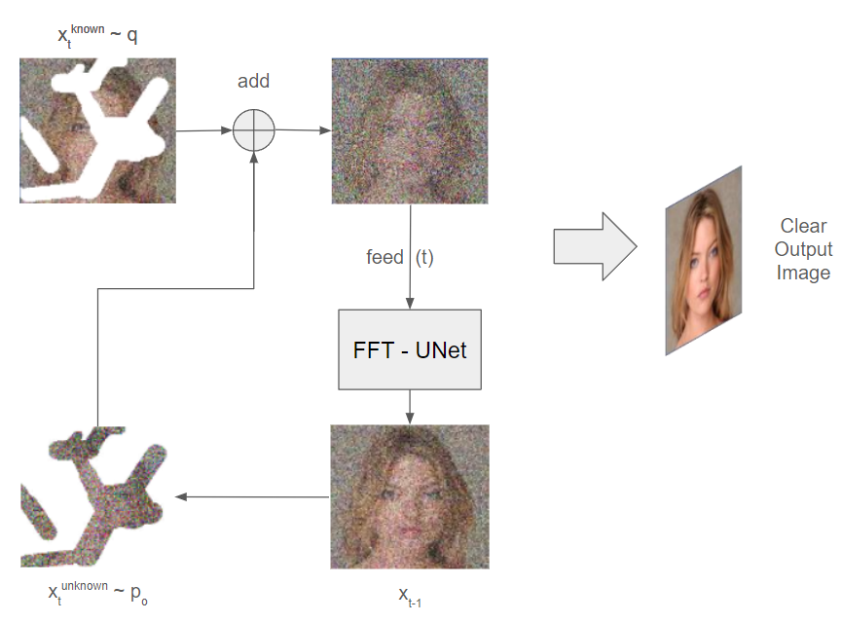
Diffusion Model using FFT-UNet
A degraded image is fed in the model.
The diffusion model shown left is trained as an unconditional DDPM.
A UNet is used as it can capture local changes and texture variations in images.
A FFT is used within the CNN to speed up the convolution operations.
Hence FFT-UNet is used.
Figure [2] DDPM using FFT-UNet Block Diagram
Figure adapted from: [2] Figure 1 Page 4, Hu, Yuxuan & Wang, Hanting & Jin, Cong & Li, Bo & Tian, Chunwei. (2022). A Diffusion Model with A FFT for Image Inpainting. JOURNAL OF Cyber-Physical-Social Intelligence. 1. 60-69. 10.61702/MTPG8588.

Slide 6
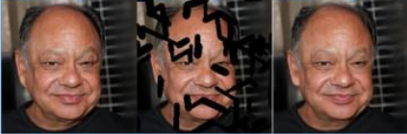
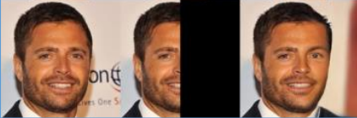

Diffusion Model using FFT-UNet
Figure [2] Mask region is small
Figure [2] Mask region is large
Figure [2] Diverse generated images
Figure source: Figure 4 Page 9, [2] Hu, Yuxuan & Wang, Hanting & Jin, Cong & Li, Bo & Tian, Chunwei. (2022). A Diffusion Model with A FFT for Image Inpainting. JOURNAL OF Cyber-Physical-Social Intelligence. 1. 60-69. 10.61702/MTPG8588.

Slide 7
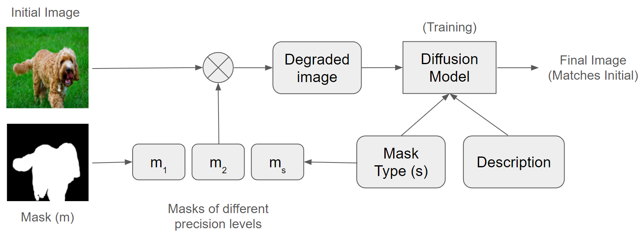
SmartBrush: Text and Shape Guided
Figure [3] Block Diagram of SmartBrush
This is multi-modal image inpainting guided by text and shape description.
The shape we input is the mask, and the text is the description.
We transform the mask m to different precision levels m_{s}, and then we decide which one is to be used.
Accordingly, the background is also preserved.
The above image shows the training of the model with different masks.
Figure adapted from: Figure 2 Page 22431, [3] S. Xie, Z. Zhang, Z. Lin, T. Hinz and K. Zhang, "SmartBrush: Text and Shape Guided Object Inpainting with Diffusion Model," 2023 IEEE/CVF Conference on Computer Vision and Pattern Recognition (CVPR), Vancouver, BC, Canada, 2023, pp. 22428-22437, doi: 10.1109/CVPR52729.2023.02148

Slide 8
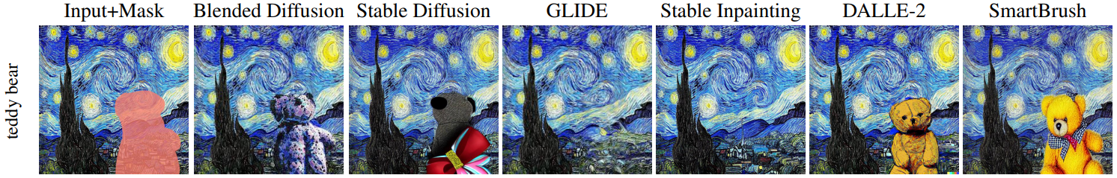
SmartBrush: Text and Shape Guided
Figure: [3] Comparison of Text and Shape Guiding
 | OpenImages |  |  | MSCOCO
 | Local FID ↓ | CLIP Score ↑ | FID ↓ | Local FID ↓ | CLIP Score ↑ | FID ↓
Blended Diffusion | 29.16 | 0.265 | 11.05 | 41.43 | 0.251 | 12.68
GLIDE | 22.45 | 0.252 | 9.70 | 30.72 | 0.241 | 9.32
Stable Diffusion | 15.28 | 0.265 | 9.10 | 25.61 | 0.250 | 12.29
Stable Inpainting | 12.57 | 0.264 | 7.07 | 18.13 | 0.246 | 8.50
SmartBrush | 9.71 | 0.266 | 6.00 | 13.22 | 0.252 | 8.05
Table: [3] Text-guided object inpainting with bounding box mask
Figure and Table source: Figure 3 Page 22431, Table 1 Page 22434, [3] S. Xie, Z. Zhang, Z. Lin, T. Hinz and K. Zhang, "SmartBrush: Text and Shape Guided Object Inpainting with Diffusion Model," 2023 IEEE/CVF Conference on Computer Vision and Pattern Recognition (CVPR), Vancouver, BC, Canada, 2023, pp. 22428-22437, doi: 10.1109/CVPR52729.2023.02148

Slide 9
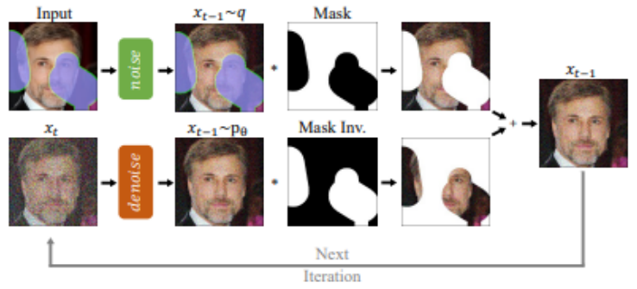
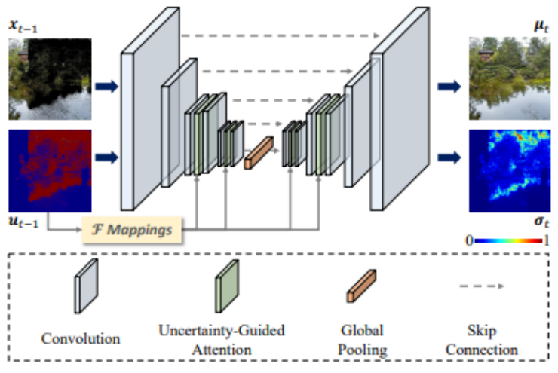
Methods in Survey
RePaint: Inpainting using DDPM
Step 1 - Use a deep neural network to generate a rough estimate of missing pixels. This gives a noisy image.
Step 2 - The DDPM iteratively refines it.
Spatial Diffusion Model
Proposed method makes use of a Markov random field.
Uses a deep neural network to roughly generate missing pixels, and then the SDM refines this image.
Figure [4] RePaint
Figure [4] SDM
Figure Source: Fig 1 and Fig 2 Page 2, [4] S. Parida, V. Srinivas, B. Jain, R. Naik and N. Rao, "Survey on Diverse Image Inpainting using Diffusion Models," 2023 2nd International Conference on Paradigm Shifts in Communications Embedded Systems, Machine Learning and Signal Processing (PCEMS), Nagpur, India, 2023, pp. 1-5, doi: 10.1109/PCEMS58491.2023.10136091.

Slide 10
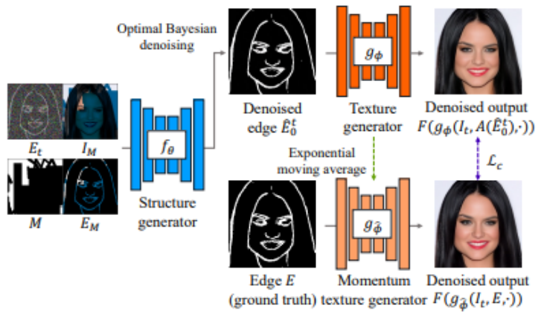
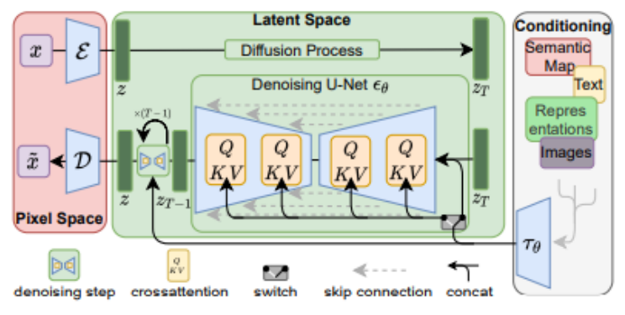
Methods in Survey
Structure Guided Diffusion Model
Proposed method utilises a UNet to generate multiple variations of the image when a large area is missing.
Disadvantage: A faulty inpaint maybe generated.
Latent Diffusion Model
This improvises our current diffusion models, thus performing the best.
The diffusion model takes advantage of image-specific inductive biases unlike the previous works which relied on autoregressive attention-based transformers for operating in discrete latent space.
Figure [4] SGDM
Figure [4] LDM
Figure Source: Fig 3 and Fig 4 Page 3, [4] S. Parida, V. Srinivas, B. Jain, R. Naik and N. Rao, "Survey on Diverse Image Inpainting using Diffusion Models," 2023 2nd International Conference on Paradigm Shifts in Communications Embedded Systems, Machine Learning and Signal Processing (PCEMS), Nagpur, India, 2023, pp. 1-5, doi: 10.1109/PCEMS58491.2023.10136091.

Slide 11
Comparisons of Methods in Survey
CelebaHQ
Methodology | FID Score | LPIPS Score
RePaint | 6.98 | 0.060
SDM | 4.05 | 0.052
SGDM | 4.68 | 0.057
LDM (big, w/ ft) | 1.50 | 0.137
LDM (big, w/o ft) | 2.40 | 0.142
LDM (w/ attn) | 2.15 | 0.144
LDM (w/o attn) | 2.37 | 0.146
Table: [4] FID and LPIPS scores of the models discussed (The LDMs are outperforming other models)
Table Adapted from: Table 1 Page 4, [4] S. Parida, V. Srinivas, B. Jain, R. Naik and N. Rao, "Survey on Diverse Image Inpainting using Diffusion Models," 2023 2nd International Conference on Paradigm Shifts in Communications Embedded Systems, Machine Learning and Signal Processing (PCEMS), Nagpur, India, 2023, pp. 1-5, doi: 10.1109/PCEMS58491.2023.10136091.

Slide 12
Conclusions
There are several diffusion models that can be used for image inpainting.
The PDE-based one utilises the fact that the most important pre-processing tasks (denoising and reconstruction) utilise partial differential equations based mathematical models, which are easy to solve and discretize.
The FFT-UNet model utilises FFT as it speeds up the convolutional operations of the CNN involved. This however has a limitation of large missing patch, where the inpainted image might not be generated as good as the original one lacking some details, as seen in the figure.
The SmartBrush is a much more improvised version of text and shape guided image inpainting by creating different levels of masks.
Finally the survey on various diffusion models analysed various models and concluded that the LDM methods are outperforming others as seen in the table on slide 11.

Slide 13
References
T. Barbu, A. Ciobanu and M. Luca, "PDE-based image restoration using variational denoising and inpainting models," 2014 18th International Conference on System Theory, Control and Computing (ICSTCC), Sinaia, Romania, 2014, pp. 688-691, doi: 10.1109/ICSTCC.2014.6982497.
Hu, Yuxuan & Wang, Hanting & Jin, Cong & Li, Bo & Tian, Chunwei. (2022). A Diffusion Model with A FFT for Image Inpainting. JOURNAL OF Cyber-Physical-Social Intelligence. 1. 60-69. 10.61702/MTPG8588.
S. Xie, Z. Zhang, Z. Lin, T. Hinz and K. Zhang, "SmartBrush: Text and Shape Guided Object Inpainting with Diffusion Model," 2023 IEEE/CVF Conference on Computer Vision and Pattern Recognition (CVPR), Vancouver, BC, Canada, 2023, pp. 22428-22437, doi: 10.1109/CVPR52729.2023.02148
S. Parida, V. Srinivas, B. Jain, R. Naik and N. Rao, "Survey on Diverse Image Inpainting using Diffusion Models," 2023 2nd International Conference on Paradigm Shifts in Communications Embedded Systems, Machine Learning and Signal Processing (PCEMS), Nagpur, India, 2023, pp. 1-5, doi: 10.1109/PCEMS58491.2023.10136091.
https://www.mdpi.com/1424-8220/20/11/3204 Global and Local Attention-Based Free-Form Image Inpainting by S. M. Nadim Uddin and Yong Ju Jung

Slide 14
Thank You!!!

